Slide 1



Meeting SHELFIE, Pisa, April 6, 2022
www.enlivenproject.eu

Slide 2

The project

Slide 3


Main ideas of ENLIVEN
ENLIVEN’s goal is developing new enhanced forms of international exchanges in HE: virtual or blended mobility.
Motivations and context:
The COVID-19 pandemic accelerated the shift to online education in a matter of days …
In the future, not everyone will be able to experience physical mobilities for different reasons (disabilities, economic, work and family reasons …)
Share experiences, analyse weak points and good practises, come up with better solutions in terms of tools, methods, guidelines, platforms and OER’s
Develop better forms of virtual mobility

Slide 4

This will achieved by …

Slide 5

This will achieved by …

Slide 6
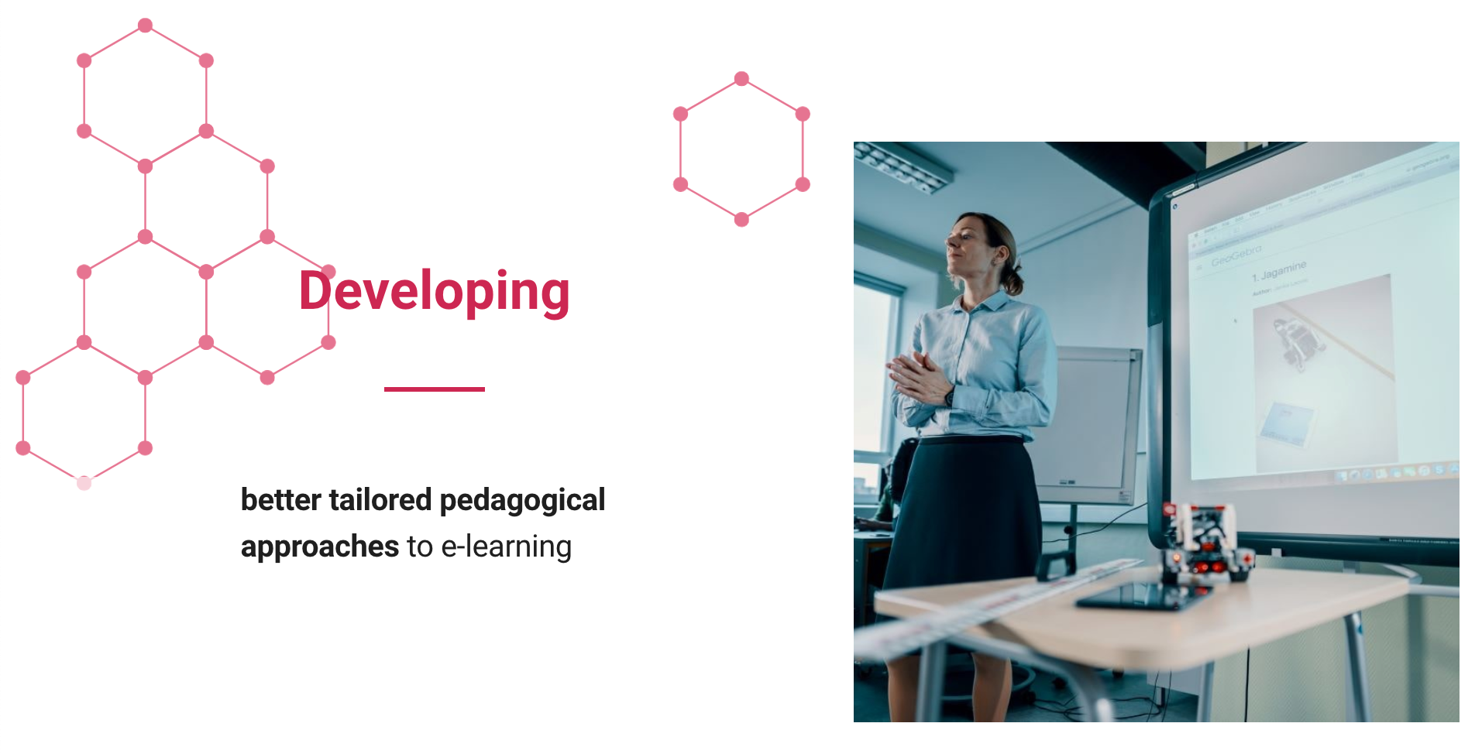
This will achieved by …

Slide 7

This will achieved by …

Slide 8





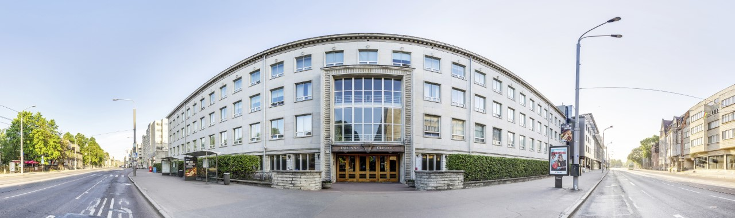
Partners
Six public universities in European cities (220,000 students and 26,000 members of staff):
University of Pisa, leader (Italy)
Tallinn University (Estonia)
NOVA University Lisbon (Portugal)
Universität Hamburg (Germany)
Paris Lodron University of Salzburg (Austria)
University of Novi Sad (Serbia)

Slide 9
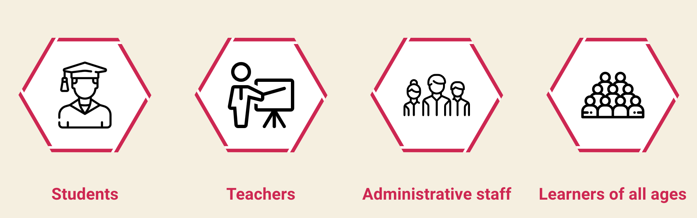
Target groups
Better support for social interaction
Practical activities and laboratories
Specific training for effective use of online environment
Improve digital skills to enhance the exercise of their profession
Benefit from the creation of flexible and open micro courses

Slide 10
Products (IO)
Three intellectual outputs …
Improving digital skills: creation of small, flexible units of learning to develop digital competences. Products: Survival kit, engagement tools, LMS, producing podcasts, webinars on correct behaviour …
Competencies in e-learning: more advanced progressive sets of course modules to be able to exploit the full potential of virtual learning. Products: video interviews, desk research, modules …
Guidelines for creating inclusive international learning environments: questionnaire, experts contribution, review of best practices in digital labs, European competences …

Slide 11
Methodology
Research
Co-creation
Testing and piloting phases in order to gather valuable feedback
Dissemination
  Nov-Dec 2022: Tallinn, Lisboa, Novi Sad, Hamburg, Saltzburg
  January 2023: Final conference in Pisa
All the relevant materials (online courses, guidelines, podcasts, papers etc.) will be publicly accessible and made available with an open license after the final release.

Slide 12

ENLIVEN Deliverables

Slide 13
Deliverables
Survival Kit
Videos and podcasts on diversity & inclusion
Questionnaire (first results)
Short-courses (micro-modules)
Podcasts on producing good digital content for teaching and learning
Webinars on ethics and norms of social behaviour in online environments
Modules for European Competences
and more

Slide 14

Survival Kit
What?
Support for the use of basic digital methods and tools in response to emerging needs in today’s learning and teaching context.
Why?
Solving basic problems in personal computers, protecting devices and mechanisms, and solving usual problems in the most common platforms used for learning and teaching

Slide 15
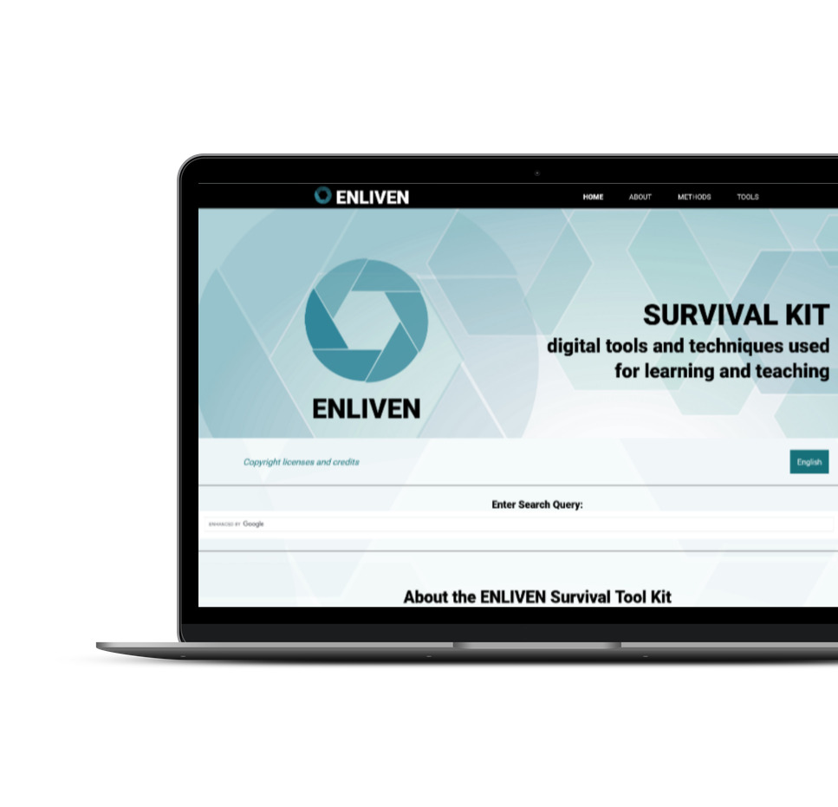

Survival Kit
Content categories based on the Digital Competence Framework (DigComp) and DigCompEdu:
  13 Tools
  12 Methods
  Translated into 5 languages (coming soon)
Check out the live version
https://www.enlivenproject.eu/survival-kit/

Slide 16
Videos and Podcasts
Main topic: Diversity & Inclusion
1 video
5 video-podcasts (interviews)
Teachers and students share their universities’ practices, some of the topics they commented on:
Personally experienced barriers to digital teaching?
Structurally experienced barriers?
Groups of students who face more challenges than others?
Recommendations to colleagues?

Slide 17

Videos and video-podcasts
Let’s watch a video
How different factors can influence our experience with the Online Learning Environment?

Slide 18

Questionnaire

Slide 19
Survey Participants
Questionnaire on the use of digital tools and the application of innovative methods in our academic community. Active from 15 September 2021 to 15 November 2021.
We collected 1285 responses:
84.7%
Students (1089)
15.3%
Teachers (196)
Country of University:
Italy: 1030 (80.1%)
Estonia: 23 (1.8%)
  Serbia: 117 (9.1%)
  Portugal: 116 (9.0%)

Slide 20
Age Distribution

Slide 21
Age Distribution
Students
Teachers

Slide 22
Distribution of Academic Field
Academic field | N = 1285 | %
Industrial and information engineering | 189 | 14.71%
Mathematics and informatics | 158 | 12.30%
Archeology, philology, literary studies, art history | 155 | 12.06%
Medicine | 141 | 10.97%
Economics and statistics | 110 | 8.56%
History, philosophy, pedagogy and psychology | 88 | 6.85%
Political and social sciences | 76 | 5.91%
Law studies | 72 | 5.60%
Biology | 68 | 5.29%
Agricultural and veterinary sciences | 66 | 5.14%
Physics | 48 | 3.74%
Chemistry | 45 | 3.50%
Other (Civil engineering, earth sciences, sports…) | 69 | 5.37%

Slide 23
Academic year 2020/2021

Slide 24
Years of Experience Using Digital Learning Environments

Slide 25
Average Daily Use of Digital Learning Environments
How much did you use any of digital learning environments on average, on a daily basis?
Students
Teachers

Slide 26
Critical Issues in Distance Learning
“Considerable increase in working time” expressed among the main critical issues of distance learning
Students
Teachers

Slide 27
International Mobility
90.7%
have not been on mobility
have been on a mobility
Students
Teachers
90.2%
93.9%

Slide 28
Format of Attended Courses
Format of courses | N = 1285 | %
Entirely online | 1007 | 78.4%
Hybrid (partly online, partly in-person) | 263 | 20.5%
Entirely in-person | 15 | 1.1%
Students
Teachers
Format of courses | N = 1089 | %
Entirely online | 870 | 79.9%
Hybrid (partly online, partly in-person) | 210 | 19.3%
Entirely in-person | 9 | 0.8%
Format of courses | N = 196 | %
Entirely online | 137 | 69.9%
Hybrid (partly online, partly in-person) | 53 | 27.0%
Entirely in-person | 6 | 3.1%

Slide 29




Format of Attended Courses
Pisa (UNIPI)
Lisbon (NOVA)
Format of courses | N = 1030 | %
Entirely online | 890 | 86.4%
Hybrid | 130 | 12.6%
Entirely in-person | 10 | 1.0%
Format of courses | N = 115 | %
Entirely online | 27 | 23.5%
Hybrid | 86 | 74.8%
Entirely in-person | 2 | 1.7%
NOVI SAAD (UNS)
TALLIN (TLU)
Format of courses | N = 117 | %
Entirely online | 83 | 70.9%
Hybrid | 32 | 27.4%
Entirely in-person | 2 | 1.7%
Format of courses | N = 23 | %
Entirely online | 7 | 30.4%
Hybrid | 15 | 65.2%
Entirely in-person | 1 | 4.3%

Slide 30
Teaching and Methods Change
Students
Teachers

Slide 31
Infrastructure, tools and resources

Slide 32
Internet Access And Quality
of respondents have internet access
98.5%
Was the Internet connection sufficiently stable and fast enough to participate in digital learning?

Slide 33
Webcam and Microphone
97.1%
of respondents have a webcam and a microphone
A quiet place to teach/study at current residence?

Slide 34







Most Used …
Learning platforms
Videoconference systems
Learning platforms | N = 1286 | %
Moodle | 878 | 68.2%
Canvas | 91 | 7.1%
Blackboard | 43 | 3.3%
I did not use any of the learning platforms | 259 | 20.10%
Videoconference | N = 2265 | %
MS Teams | 1149 | 50.7%
Google Classroom | 444 | 19.6%
Zoom | 427 | 18.9%
Other (Webex, BigBlueButton..) | 245 | 10.8%

Slide 35
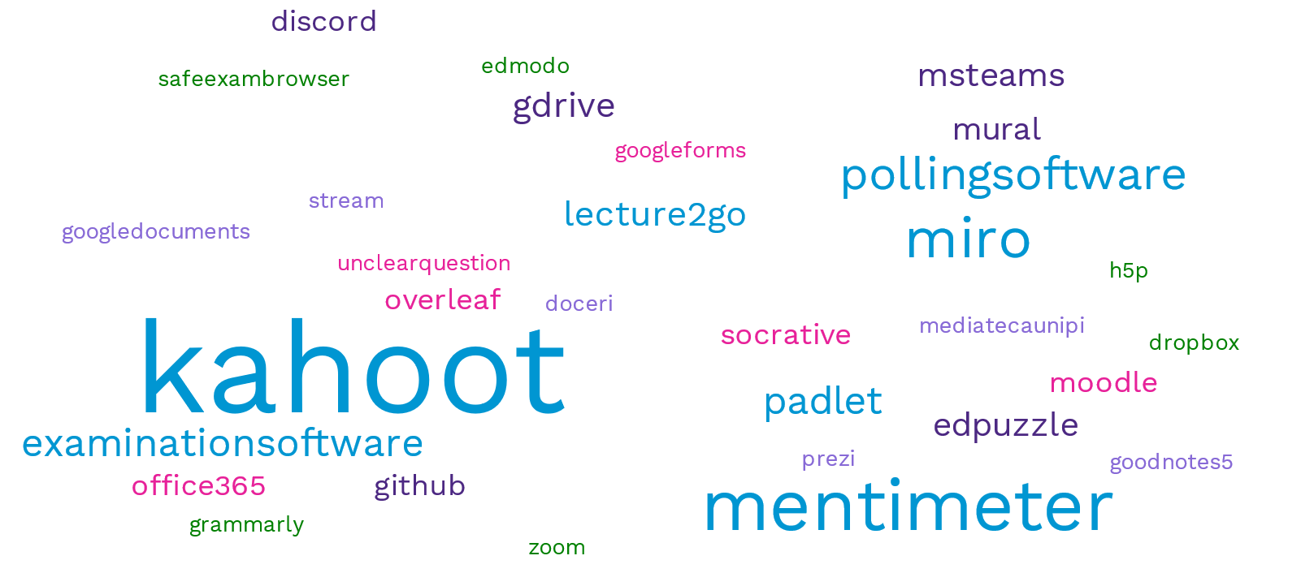
Tools for Engagement

Slide 36
Tools for Engagement

Slide 37
Tools for Engagement
Engagement Tools | N = 1383 | %
I did not use any of tools for engagement | 999 | 72.2%
Kahoot | 143 | 10.3%
Mentimeter | 53 | 3.8%
Miro | 46 | 3.3%
Padlet | 34 | 2.5%
49 answers (+12.8%)
were not engagement tools!
Engagement Tools | N = 1383 | %
I did not use any of tools for engagement | 1048 | 75.8%

Slide 38

Support from university in the transition from in presence to distance learning and rating of satisfaction

Slide 39
Support Received From University
Students
Teachers

Slide 40
Type of Training and support received

Slide 41
Rating of Experience in using Digital Platforms
“How would you rate your experience in employing the available platform for distance learning used by your University with reference to the following items?”
Very Difficult (1)
Difficult(2)
Neither difficult nor easy (3)
Easy (4)
Very Easy (4)

Slide 42
Rating of Satisfaction in using Digital Platforms
“How would you rate your satisfaction in using digital platforms at your University with reference to the following items?”
Teachers

Slide 43
Rating of Satisfaction in using Digital Platforms
“How would you rate your satisfaction in using digital platforms at your University with reference to the following items?”
Students

Slide 44
Main Critical Issues expressed by Teachers
… that have changed teaching and learning during the pandemic
Critical Issue (teachers) | N = 189 | %
Difficulty in increasing the sense of belonging through distance learning, gained by participation, empathy, and effective communication | 142 | 72.4%
Considerable increase in working time | 117 | 59.7%
Difficulties in delivering/attending practical subjects / laboratories through distance teaching/learning | 100 | 51.0%
Increased stress and physical fatigue | 77 | 39.3%
Increase in the number of absences and lack of participation | 74 | 37.8%
Digital divide / IT issues | 66 | 33.7%
Increased difficulty in understanding what was explained / assigned | 66 | 33.7%
Difficulties in the overall organization of work and in distance teaching activities | 61 | 31.1%
Dispersal of information | 34 | 17.3%
Difficulty in guaranteeing assistance and educational support to persons with disabilities | 24 | 12.2%
Increase in cases of discomfort | 20 | 10.2%
Economic impact of distance learning for teachers and students | 17 | 8.7%

Slide 45
Main Critical Issues expressed by Students
… that have changed teaching and learning during the pandemic
Critical Issue (students) | N = 1089 | %
Difficulty in increasing the sense of belonging through distance learning, gained by participation, empathy, and effective communication | 610 | 56.0%
Difficulties in delivering/attending practical subjects / laboratories through distance teaching/learning | 534 | 49.0%
Digital divide / IT issues | 482 | 44.3%
Considerable increase in working time | 268 | 24.6%
Dispersal of information | 319 | 29.3%
Difficulties in the overall organization of work and in distance teaching activities | 390 | 35.8%
Increased stress and physical fatigue | 426 | 39.1%
Increase in the number of absences and lack of participation | 317 | 29.1%
Increase in cases of discomfort | 233 | 21.4%
Difficulty in guaranteeing assistance and educational support to persons with disabilities | 133 | 12.2%
Increased difficulty in understanding what was explained / assigned | 319 | 29.3%
Economic impact of distance learning for teachers and students | 123 | 11.3%

Slide 46

Keep in Touch
https://www.enlivenproject.eu
Twitter: @ENLIVEN_Erasmus
Facebook: @ENLIVEN.Erasmus+

Slide 47




References
Survival Kit:
https://www.enlivenproject.eu/survival-kit/
Requirement analysis (questionnaire report):
https://www.enlivenproject.eu/it/2022/01/28/requirement-analysis-report-on-the-online-survey/
Images/illustrations courtesy of undraw.com
www.enlivenproject.eu

Slide 48
Contacts
Website https://www.enlivenproject.eu
Maria Simi
maria.simi@unipi.it
Lukasz Szczygiel
l.szczygiel@protonmail.com
www.enlivenproject.eu

